Slide 1
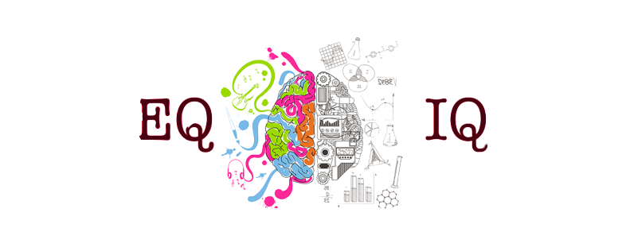


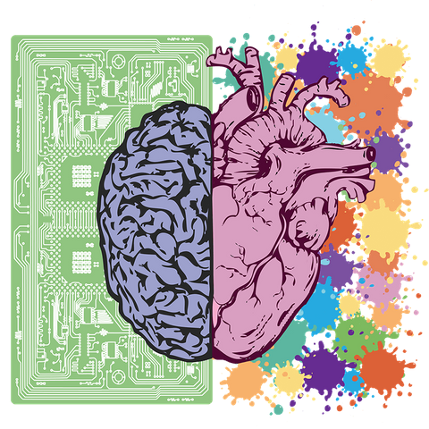


Business Communication
EMOTIONAL INTELLIGENCE
VS
COGNITIVE INTELLIGENCE
Tanishq Verma
MBA19049

Slide 2

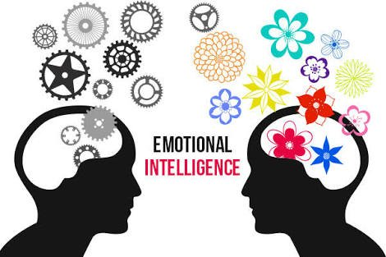

Emotional Intelligence

Slide 3

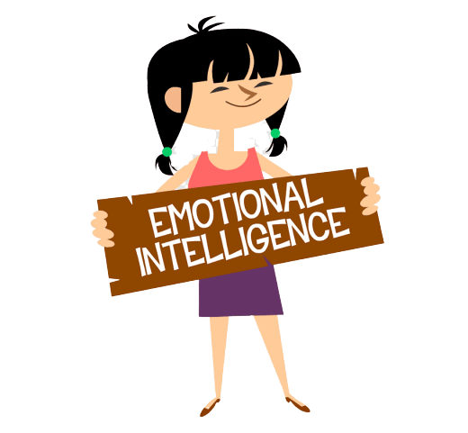

Emotional Intelligence
Emotional intelligence (otherwise known as emotional quotient or EQ) is the ability to understand, use, and manage your own emotions in positive ways to relieve stress, communicate effectively, empathize with others, overcome challenges and defuse conflict. Emotional intelligence helps you build stronger relationships, succeed at school and work, and achieve your career and personal goals. It can also help you to connect with your feelings, turn intention into action, and make informed decisions about what matters most to you.
https://youtu.be/LgUCyWhJf6s
-Video Link

Slide 4
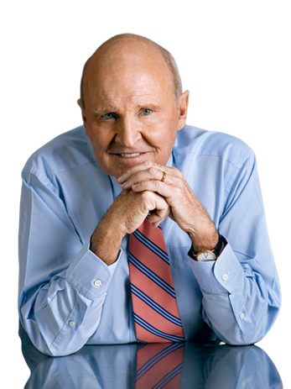
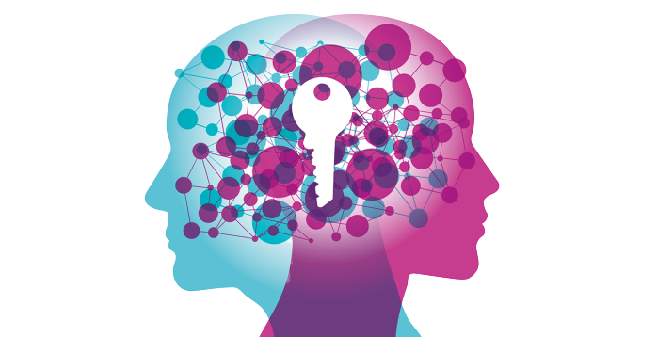

“No doubt emotional intelligence is more rare than book smarts, but my experience says it is actually more important in the making of a leader. You just can’t ignore it.” –Jack Welch

Slide 5
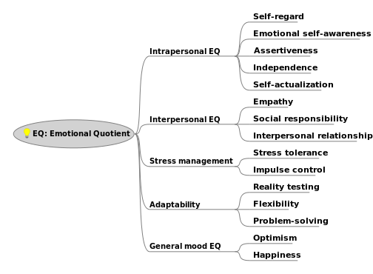

Slide 6
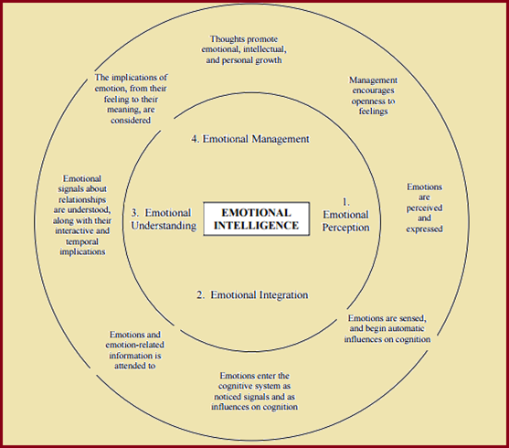
Range

Slide 7
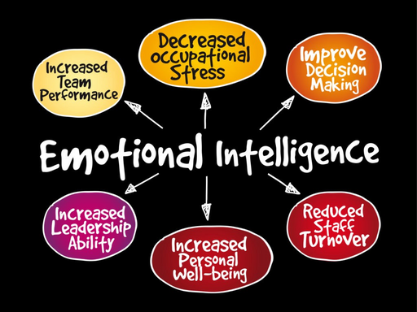
Affects of Emotional Intelligence
Performance at school or work
Physical health
Relationships
Mental health
Social intelligence

Slide 8



11 Signs That You Lack Emotional Intelligence
1. You get stressed easily.
3. You have a limited emotional vocabulary.
2. You have difficulty asserting yourself
4. You hold grudges.
5. You make assumptions quickly and defend them vehemently.
7. You often feel misunderstood.
8. You don’t know your triggers.
6. You don’t let go of mistakes.
9. You don’t get angry.
10. You blame other people for how they make you feel.
11. You’re easily offended.

Slide 9

THE 4 PILLARS OF EMOTIONAL INTELLIGENCE
SELF-MANAGEMENT
SELF AWARENESS
RELATIONSHIP MANAGEMENT
SOCIAL AWARENESS

Slide 10
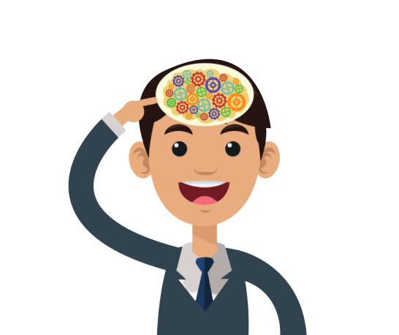
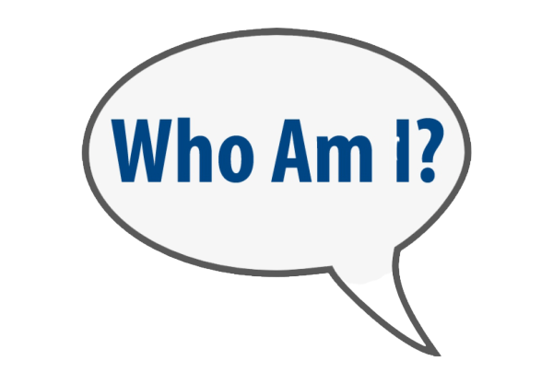
SELF-AWARENESS
Emotional Self-Awareness, the ability to know yourself and understand your feelings.
Accurate Self-Assessment, understanding your strengths and weaknesses and their effects.
Self-Confidence, having faith in yourself and being willing to put yourself forward.

Slide 11
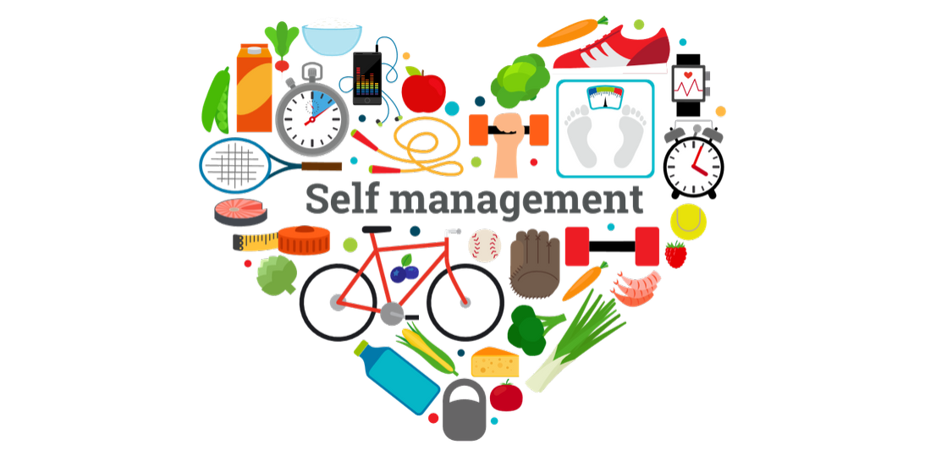
SELF-MANAGEMENT
Emotional Self-Control, an important part of emotional maturity, controlling your feelings and/or expressing them in the appropriate settings is a key skill.
Achievement, i.e. being goal-oriented and being able to work toward your goals.Initiative, being self-motivated, and having the ability to keep working despite setbacks.
Transparency, being honest and open, interacting with integrity and being trustworthy.
Adaptability, showing resilience and the ability to change course when necessary.
Optimism, having a positive outlook, hoping for the best and preparing for success.

Slide 12


SOCIAL AWARENESS
Empathy, one of the pillars of the ability to form connections with others, understanding and acknowledging others’ emotions.
Service Orientation, being helpful, contributing to the group effort, and displaying good listening skills.
Organizational Awareness, the ability to explain yourself well and be aware of how you are being understood, as well as sensing the level of comprehension of your audience.

Slide 13

RELATIONSHIP MANAGEMENT
Inspirational Leadership, like being a good mentor, role model, and authority figure.
Influence, articulating points in persuasive, clear ways that effectively motivate others.
Conflict Management, having the skills to improve relationships, negotiate, and lead. The ability to settle disputes, differences of opinion, and misunderstandings.
Change Catalyst, recognizing and supporting the need for change, and making it happen.
Developing others, helping others build their skills and knowledge.
Teamwork and Collaboration, working with others in an effective manner.

Slide 14
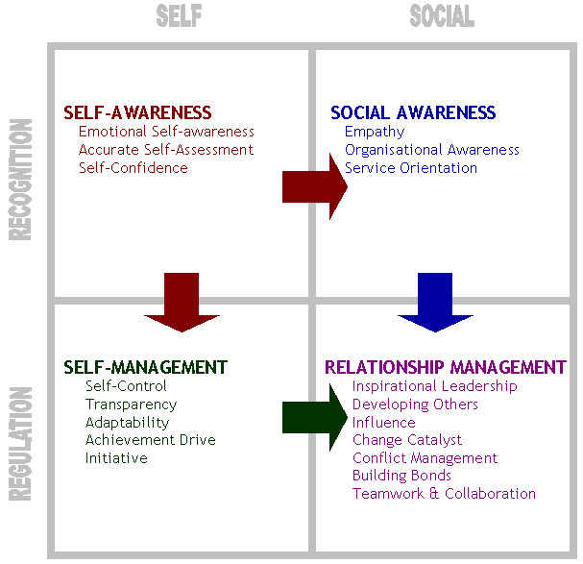

Slide 15



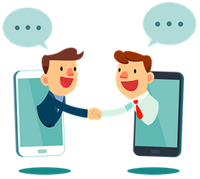
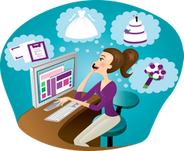
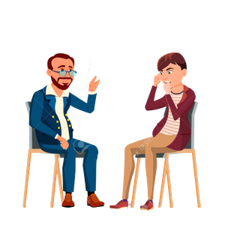

The best careers for emotionally intelligent people.
Teacher
Poker Player
Team Manager
Customer Service Representative
Funeral/Wedding Planner
Psychologist
Politician

Slide 16
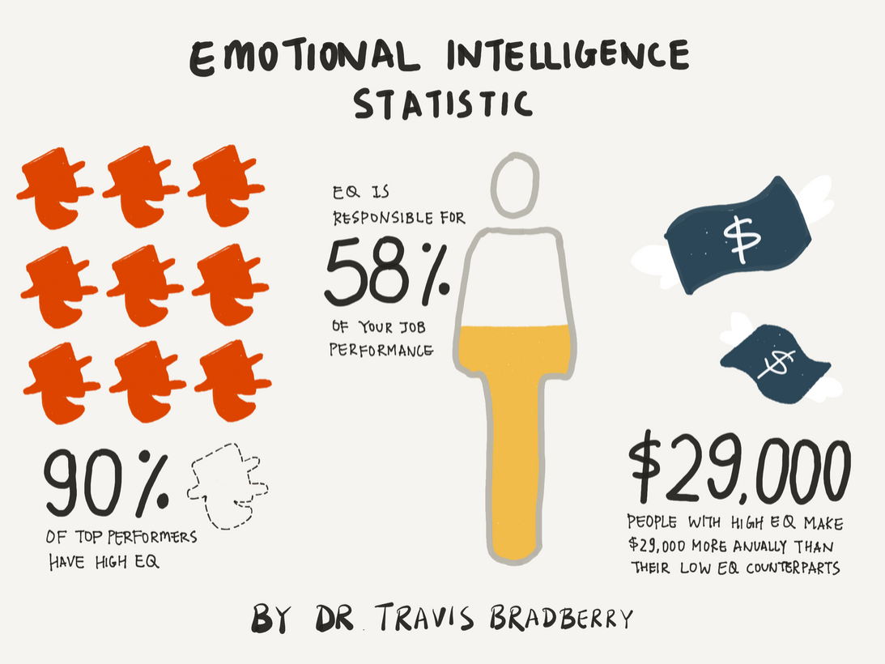
Presentations are communication tools that can be used as lectures, speeches, reports, and more.

Slide 17
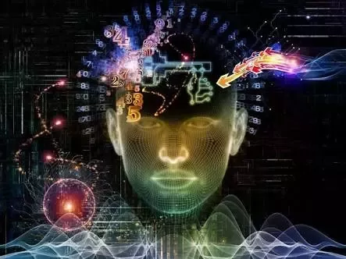
Presentations are communication tools that can be used as lectures, speeches, reports, and more.
Cognitive Intelligence

Slide 18
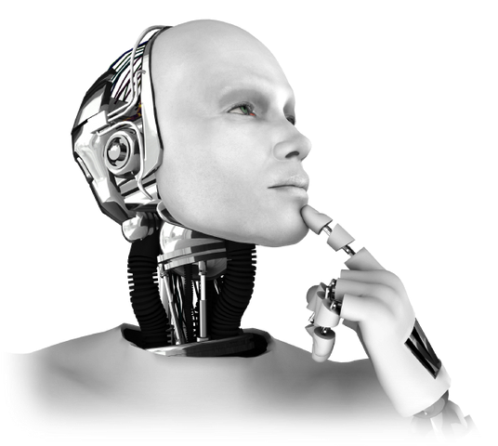
Cognitive Intelligence
Cognitive Intelligence, as well as being a part of Artificial Intelligence, is an area that mainly covers the technology and tools that allow our apps, websites and bots to see, hear, speak and understand the needs of the user through natural language. They are they AI apps that allow machines to learn their users’ language so that the users don’t have to learn the language of machines. AI, for its part, is a much wider concept that includes technology and innovations such as robotics, Machine Learning, Deep Learning, neural networks, NLP etc.

Slide 19
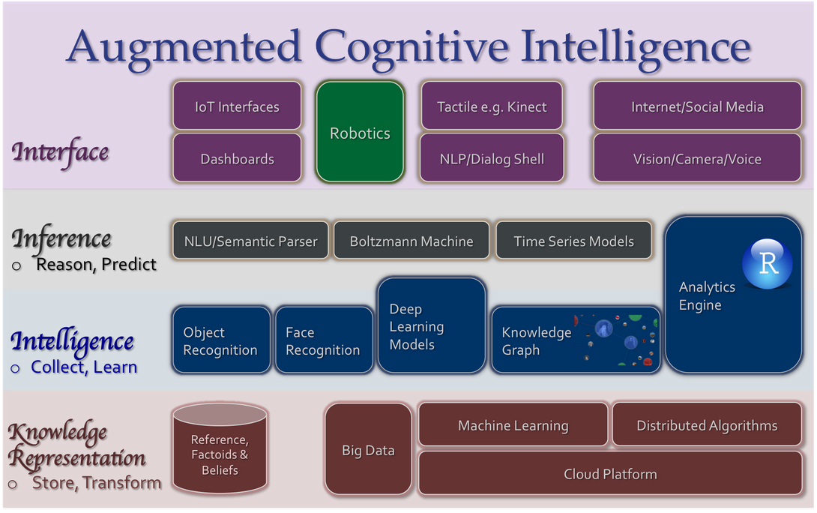
Types of Cognitive Intelligence

Slide 20
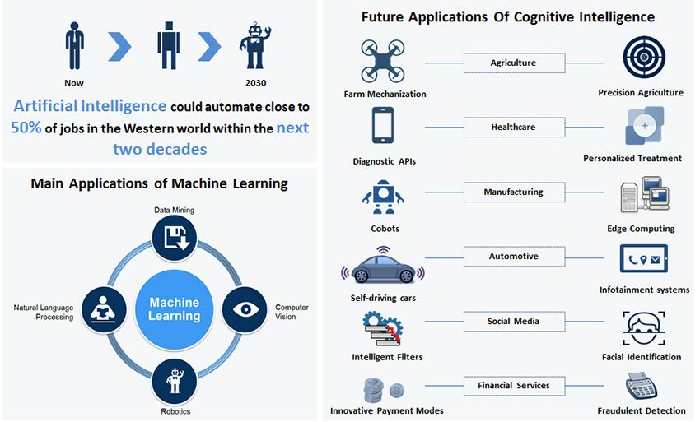
Future of Cognitive Intelligence

Slide 21
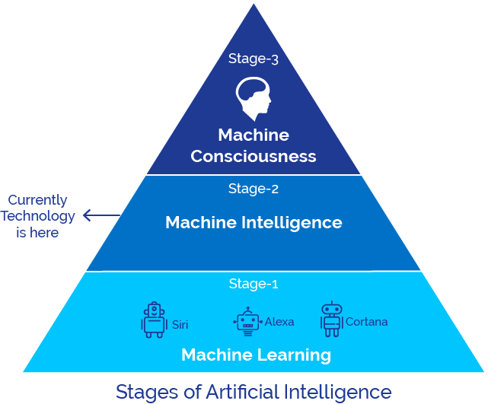
Stages

Slide 22
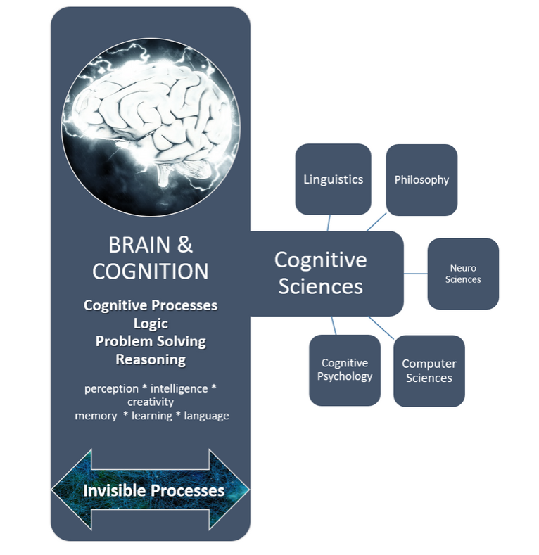
Uses Of Cognitive Intelligence

Slide 23
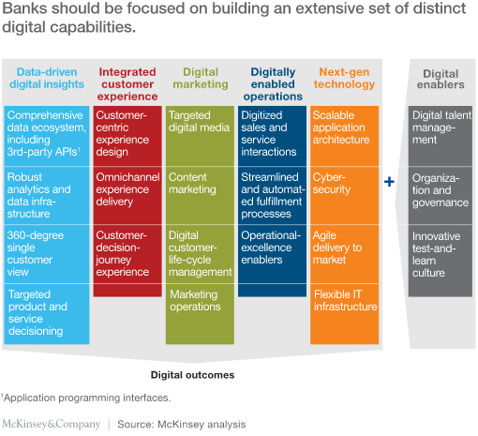

Slide 24
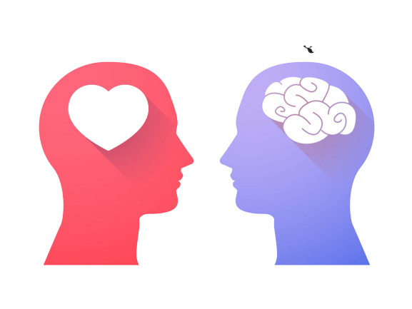
EQ vs IQ

Slide 25
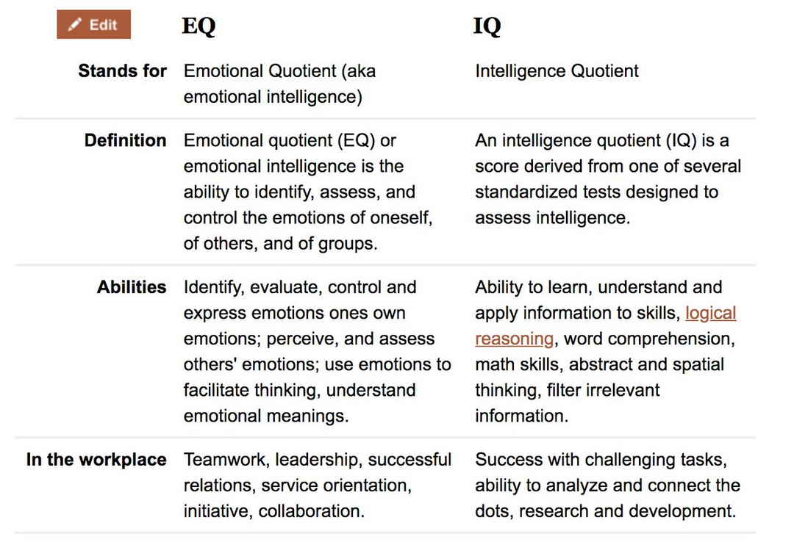

Slide 26
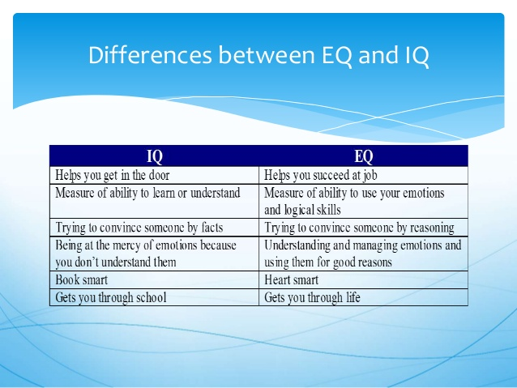

Slide 27
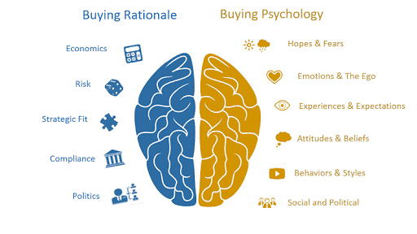
EQ vs IQ Brain Mapping

Slide 28
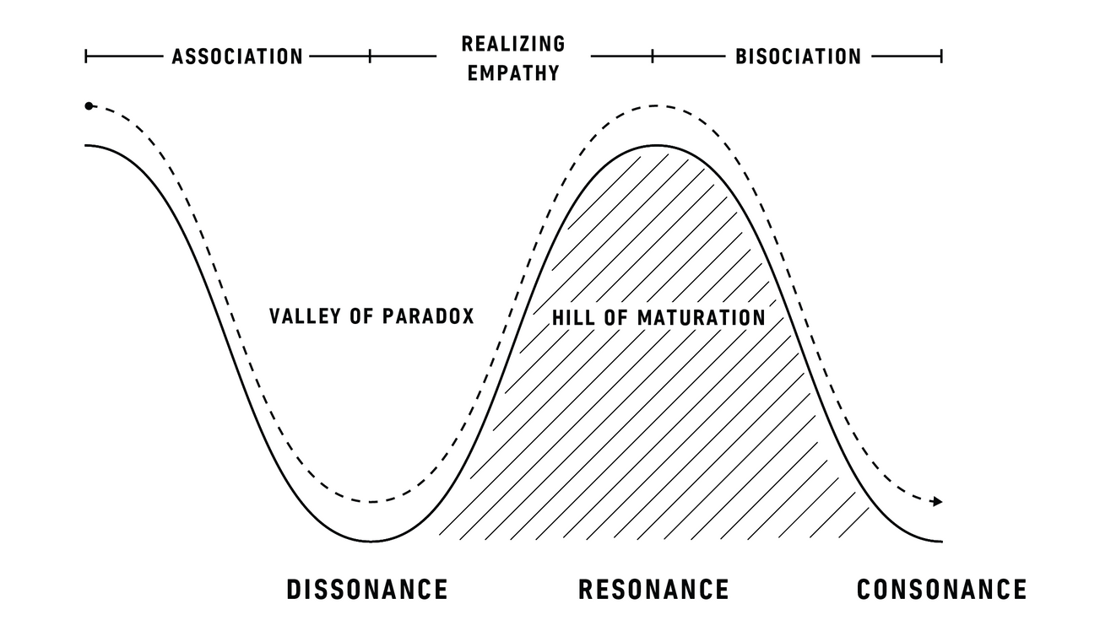
EQ vs IQ

Slide 29
Can EQ or IQ be Enhanced?
Emotional awareness is best inculcated from an early age by encouraging qualities like sharing, thinking about others, putting oneself in another person's shoes, giving individual space and the general principles of cooperation. There are toys and games available to increase emotional intelligence, and children who do not do well in social settings are known to perform significantly better after taking SEL (Social and Emotional Learning) classes. Adult EQ can also be enhanced, although to a limited extent through effective coaching.
IQ is more of a genetic make, but there are several ways to tap an individual's IQ to its highest potential through brain-food and mental ability exercises like puzzles, lateral thinking problems, and problem-solving techniques that make you think outside the box.

Slide 30
Top 4 Reasons EQ Determines Success in Life
2. The ability to delay gratification is a primary indicator of future success.
1. EQ has a greater impact on success than other factors.
Delayed gratification is the top predictor of future success. People who are able to pay the price today and delay the rewards are much more likely to succeed in life. Unfortunately we have become a nation seeking instant gratification. This shows up in our everyday lives in the foods we choose to eat, the buy-now-pay-later way of life, our difficulty in adhering to an exercise regimen, and putting mindless entertainment ahead of self-development.
It has been said that your IQ can land you a job, but your lack of EQ can get you fired. Your IQ only accounts for 20% of your success in life. Your emotional intelligence and social intelligence are much greater determinants of the success you will achieve in life.
4. Emotional health impacts physical health.
3. High EQ leads to healthy relationships with others.
There is a direct connection between our emotional health and our physical health. If our lives are filled with stress, our physical health suffers. It has been estimated that well over 80% of our health problems are stress-related. We experience stress primarily because we are not comfortable emotionally. We need to understand the link between our emotional health and our physical health.
Our emotional skills have a direct and important bearing on our relationships with others. We need to understand our feelings, where they come from, and how to properly express them. We will not maintain healthy relationships unless we can control our emotions, communicate our feelings in a constructive manner, and understand the feelings of others.

Slide 31
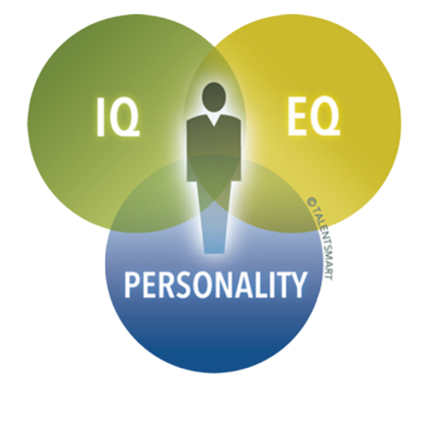
Conclusion
I think both EQ and IQ should be used together for a person to achieve success in their lives. However, if I must choose, I believe EQ is slightly more important than IQ because it develops one's ability to judge and react to people around them. If one was simply intelligent, but could not get along with others, achieving success would be a huge struggle. EQ and IQ are the difference between being able to function well and being able to function well enough to succeed.

Slide 32
THANK YOU

